Slide 1


Implementation of Linear Regression Models in R
Notes:
In this presentation we discuss how linear regression models can be implanted using R and we provide examples.

Slide 2
Implementation of Linear Regression Models in R
In R, the lm(), or “linear model” function can be used to create a simple regression model.
The lm() function accepts a number of arguments (“see ? lm”). The two most commonly used parameters are formula and data
Formula describes the model structure and follows a specific format. For simple linear regression, this is “Y~ X” where Y is the dependent, or predicted, variable and X is the independent, or predictor, variable.
Data parameter defines the dataframe that variables belong to if they are not explicitly defined as individual vectors.
Notes:
In R, the lm or linear model function can be used to create a simple linear regression model. The function accepts 2 different parameters, but the 2 most important parameters are data and formula. The formula describes the model structure, which means that it defines which variables are independent variables, and which variables are dependent variables. In the case of simple linear regression, we have one independent, and one dependent variable, where specifically the tail symbol is used to define the relationship between the dependent and independent variable. In this case, Y tail of X defines a formula where Y is the dependent variable and X is the independent variable. The data parameter defines a name of the data frame the variable belongs to. If X and Y are explicitly defined as individual vectors, there is no need to define the data parameter.

Slide 3
Airline Cost Example in R
X=c(61,63,67,69,70,74,76,81,86,91,95,97) Y=c(4.28,4.08,4.42,4.17,4.48,4.3,4.82,4.7,5.11,5.13,5.64,5.56) Model=lm(Y ~X) # lm() is the function to create linear model of Y from X Model$coefficients
## (Intercept) X ## 1.5697928 0.0407016
Model$residuals
## 1 2 3 4 5 6 ## 0.22740971 -0.05399349 0.12320012 -0.20820308 0.06109532 -0.28171107 ## 7 8 9 10 11 12 ## 0.15688573 -0.16662226 0.03986975 -0.14363825 0.20355536 0.04215216
Model$fitted.values
## 1 2 3 4 5 6 7 8 ## 4.052590 4.133993 4.296800 4.378203 4.418905 4.581711 4.663114 4.866622 ## 9 10 11 12 ## 5.070130 5.273638 5.436445 5.517848
Notes:
Lets consider the lm cost example again. In this case, X defines the number of passengers, and Y defines the cost of airlines in thousands of dollars. As we said, we can use the lm function to create a linear model of X and Y. So we define the model as lm Y tail X. for executing this line, a model is constructed and stored in a variable called model. We can look at the coefficients of the model by calling model $ coefficients which in that case we can see the intercept being 1.5 and the coefficient for the x variable is 0.04. we can also examine the residuals as well, so model $ residuals prints out the residuals for all the 12 data points. Model $ fitted values gives us estimated values of Y based on the model. So in this case you can see that the first fitted value is 4.05 where as the actual value was 4.28 therefore the difference between the 2 is 0.22, shown as the first element of the residuals.

Slide 4
Airline Cost Example in R
summary(Model)
## Call: ## lm(formula = Y ~ X) ## ## Residuals: ## Min 1Q Median 3Q Max ## -0.28171 -0.14938 0.04101 0.13162 0.22741 ## ## Coefficients: ## Estimate Std. Error t value Pr(>|t|) ## (Intercept) 1.569793 0.338083 4.643 0.000917 *** ## X 0.040702 0.004312 9.439 2.69e-06 *** ## --- ## Signif. codes: 0 '***' 0.001 '**' 0.01 '*' 0.05 '.' 0.1 ' ' 1 ## ## Residual standard error: 0.1772 on 10 degrees of freedom ## Multiple R-squared: 0.8991, Adjusted R-squared: 0.889 ## F-statistic: 89.09 on 1 and 10 DF, p-value: 2.692e-06
P-values
Notes:
Summary function is also very useful and provides interesting insight about the model. So by calling summary model, the following outputs are printed. First, we can see the model formula, which in this case is Y tail X, as we expected. Also, the statistics of the residuals are shown as we see later on, we would like the residuals to be centered around 0 and to be symmetric around 0. So in this case the minimum value is -0.28 and the maximum value is 0.22, which suggest that the residuals are almost symmetric. Also, the estimates of the coefficient values are shown. So in this case the estimates for coefficients of intercepts are 1.56 as we saw before, and for X is 0.04. We also see the p value and the t value here. These correspond to the hypothesis test, where the coefficient has been set to 0. So ideally, if you want to see any statistically significant relationship between the dependent variable and any of the independent variables, you would like to see the p value being as small as possible. So the p value is the probability that the hypothesis that that particular coefficient is equal to 0 is true. So if this probability is small, we can reject that hypothesis, and we can make a conclusion that there are statistically significant relationships between the two variables. In this case, we can see that both intercept and the coefficient for x have a very small p value. And therefore we would consider them statistically significant. In general the p value for intercept is not really important. We will discuss the other outputs of the summary model later in this module.

Slide 5
Example
Executives of a video rental chain want to predict the success of a potential new store. The company’s researcher begins by gathering information on number of rentals and average family income from several of the chain’s present outlets.
Develop a regression model to predict the number of rentals per day by the average family income. Comment on the output.
Rentals=c(710, 529,314,504,619,428,317,205,468,545,607,694) Average_Family_Income_k=c(65,43,29,47,52,50,46,29,31,43,49,64)
Notes:
Let’s consider another example. In this example, executives of a video rental chain want to predict the success of a potential new store. The company’s researcher begins by gathering information on number of rentals and average family income from several of the chain’s present outlets. In this case, we have 2 variables, the number of rentals which we try to predict, and the average family income. The average family income is expressed in thousands of dollars, as we can see here. In this case we want to develop a regression model to predict the number of rentals per day based on the average family income.

Slide 6
Example
model=lm(Rentals~Average_Family_Income_k) summary(model)
## Call: ## lm(formula = Rentals ~ Average_Family_Income_k) ## Residuals: ## Min 1Q Median 3Q Max ## -181.54 -32.10 6.87 65.90 128.85 ## ## Coefficients: ## Estimate Std. Error t value Pr(>|t|) ## (Intercept) 9.729 115.515 0.084 0.93455 ## Average_Family_Income_k 10.626 2.454 4.330 0.00149 ** ## --- ## Signif. codes: 0 '***' 0.001 '**' 0.01 '*' 0.05 '.' 0.1 ' ' 1 ## ## Residual standard error: 97.13 on 10 degrees of freedom ## Multiple R-squared: 0.6522, Adjusted R-squared: 0.6174 ## F-statistic: 18.75 on 1 and 10 DF, p-value: 0.001489
Notes:
Again we will be using the lm function to create the linear model. In this case we have model = lm rentals tail average family income, which basically tells R that the independent variable in this case is average family income and the dependent variable is the rentals. By looking at the summary of model, we can see that the residuals are not perfectly symmetric around 0, however, even though we only have a few data points in here, we cannot really expect perfect symmetry. Moving forward, we can see the intercept value is 9.72 and the coefficient for the average family in thousands of dollars is 10.62. looking at the p value for the average family income coefficient, we can see that the p value is equal to 0.001 which is a very small number and suggest that the average family income is a significant predictor in this case. The coefficient is also positive which means that increase in the average family income results in the increase in the number of rentals, which makes intuitive sense a well. More specifically, the value is 10.62. we can interpret this by saying that for every unit increase in the average family income in thousands of dollars, we can expect to see 10.62 units of increase in the number of rentals per day.

Slide 7
Example
Rentals=10.626* Average_Family_Income_k+ 9.729
The model says, there will be a 10.62 unit increase in average number of rentals for every $1000 increase in the average households income
of the local neighborhood. ➔ more income, more spending on video rentals
So based on this model, what would be the average rental for a neighborhood where the average household income is $86k ?
Rentals=10.626* 86+ 9.729=923.565
Notes:
Now that we have calculated the coefficient, we can actually write the question for the linear model for the rentals. In this case rentals is equal to 10.626 multiplied by the average family income in thousands of dollars plus 9.729. The model actually says that there will be 10.62 units of increase in the average number of rentals for every $1000 increase in the household income of the local neighborhood. This makes intuitive sense as well, the more income, the more spending there will be on the video rentals. So the goal for building any model is to use the model to make predictions. Let’s use the model and try to predict the number of rentals for a store with average local neighborhood income of $86,000 (in the voice over you said $68,000). To calculate the rentals, we can actually plug 86 instead of the actual family income and calculate the rentals. In this case we have rentals equal to 10.626 multiplied by 86 plus 9.729, which the result is 923.565, which would be the average number of rentals per day for the new store.

Slide 8
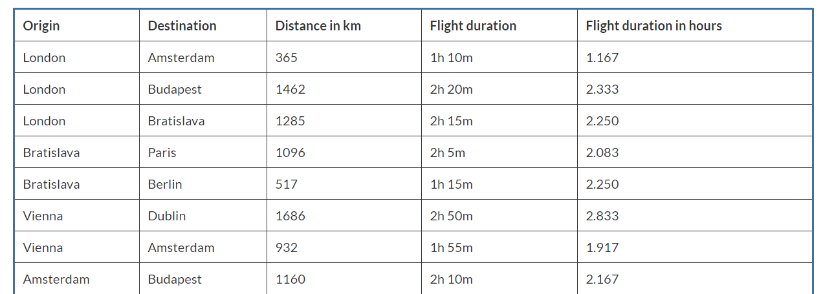
Example
Use the following data to build model that predicts the flight duration (in hours) given the distance between the source and destination.
Notes:
Let’s consider another example. In this case we are trying to predict the duration of a flight given the distance between the source and the destination. So the table in here, a number of cities are listed as origin and a number of cities are listed as destination, the distance between the two cities are given, and the flight duration is also provided.

Slide 9
Example
Distance=c(365,1462,1285,1096,517,1686,932,1160) Duration=c(1.167,2.333,2.25,2.083,2.25,2.833,1.917,2.167) Model=lm(Duration~Distance) Model$coefficients
## (Intercept) Distance ## 1.233589015 0.000838679
Notes:
This is a slide show of a quick implementation of the model. We have one variable as distance and the other variable as duration, model is defined as lm duration tail distance, and then we can look at coefficients of the model. So we can see that the coefficient for distance is obviously positive, which means that the higher the distance between the two cities, the longer the flight will be.

Slide 10
Example
summary(Model)
## Call: ## lm(formula = Duration ~ Distance) ## ## Residuals: ## Min 1Q Median 3Q Max ## -0.37271 -0.10536 -0.06554 0.01676 0.58281 ## ## Coefficients: ## Estimate Std. Error t value Pr(>|t|) ## (Intercept) 1.2335890 0.2911120 4.238 0.00545 ** ## Distance 0.0008387 0.0002547 3.292 0.01657 * ## --- ## Signif. codes: 0 '***' 0.001 '**' 0.01 '*' 0.05 '.' 0.1 ' ' 1 ## ## Residual standard error: 0.3024 on 6 degrees of freedom ## Multiple R-squared: 0.6437, Adjusted R-squared: 0.5843 ## F-statistic: 10.84 on 1 and 6 DF, p-value: 0.01657
Notes:
Lets examine the model output in here. So we can again use the summary of the model and we can see that the residuals are now perfectly symmetric as we were expecting given the low number of data points. The estimate for the coefficients of the intercept and the distance are also given as we have before. The results also show that the distance is a statistically significant variable in here given that the p value is very small. In this case it is equal to 0.01 and therefore we can conclude that distance has a statistically significant relationship with the duration of the flight as one might expect.

Slide 11
Example
Duration= 0.0008387* Distance+ 1.2335890
We can reason that the flight duration time consists of two times - the first is the time to take off and the landing time; the second is the time that the airplane moves at a certain speed in the air. The first time is some constant. The second time depends linearly on the distance.
With this model, what how long will be the flight from Bratislava to
Amsterdam if the distance is 978km?
Duration= 0.0008387* 978+1.2335890=2.053838 => 2:03’ (2 hours and 3 minutes)
Notes:
Again similar to the previous example, given the coefficient we can write the linear equation explicitly in here as well. Also, if we look at the equation, we can reason that the flight duration time consists of 2 elements. The first is the time for takeoff and landing which is independent of the distance between the 2 cities and reflected by the fixed coefficient in this equation. And the second component of the duration is the distance dependent component. Now again, using the model we can do any prediction; so if we want to predict the flight time between Bratislava and Amsterdam, we just need to know the distance between the two cities. In this case it’s 978 kilometers. For plugging the numbers, the duration of flights would be 2 hours and 3 minutes.

Slide 12
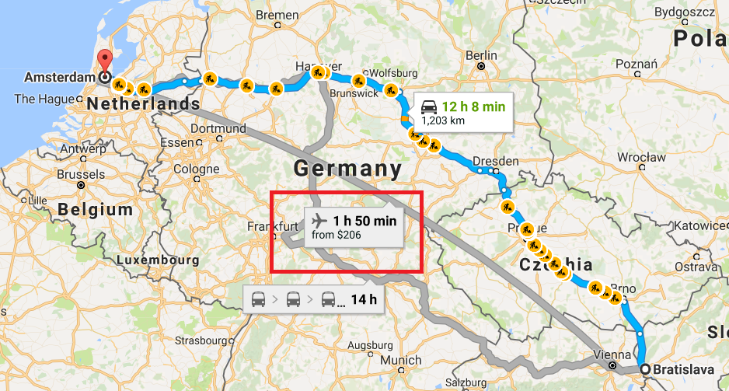
Example
Notes:
Using the Google map, we can see that after all the prediction wasn’t too bad, as the flight duration shown by the Google map is 1 hour and 50 minutes.

Slide 13
Using R predict() function
Distance=c(365,1462,1285,1096,517,1686,932,1160) Duration=c(1.167,2.333,2.25,2.083,2.25,2.833,1.917,2.167) Model=lm(Duration~Distance) Predicted_value <- predict(Model, data.frame(Distance=c(978))) Predicted_value
## 1 ## 2.053817
Notes:
So far we have been using R to build linear regression models; once we have the model, we are looking at the coefficient and we are using the coefficients to make any predictions that we wanted to do. There is actually an easier way to make predictions. The predict function in R makes it easier to use the model to make any predictions. So let’s consider the previous example; in that case we had the distance and duration. The model can be constructed using the lm function. So in this we have lm duration tail distance. Once the model is constructed, we can use the predict function and provide the name of the model object and also provide a new data frame that contains data points where we need to make predictions for. The requirement in here however, is that the data for which we need to make predictions for needs to be expressed in the form of a data frame. So in this case if we want to make a prediction for a distance value of 978 kilometers, we need to convert this into a data frame. The command for doing that is data.frame and then we can pass the name of the variable. Doing so we can see that the predicted value is calculated and if we print that it is 2.05, which is exactly what we have calculated before. The predict function would be especially useful if we want to make predictions on a large number of data points.

